Slide 1



24ITT41 - DESIGN AND ANALYSIS OF ALGORITHM
TOPIC : DECREASE AND CONQUER – TOPOLOGICAL SORTING USING DAG
- HARSHITHA U M
(24ITR048)

Slide 2
PROBLEM STATEMENT :
In many real-world systems, certain tasks must be completed before others.
Examples:
• Course prerequisites
• Project scheduling
• Build systems in software development
Represent tasks and dependencies as a Directed Acyclic Graph (DAG)
Each Task → Vertex
Each Dependency → Directed Edge
Find a valid order of execution using Topological Sorting

Slide 3
OBJECTIVE
To model project tasks using graph representation
To determine a valid execution order of tasks
To avoid dependency conflicts
To apply Topological Sorting algorithm
To detect cycles (invalid project structure)

Slide 4
ALGORITHM DESIGN TECHNIQUE
DFS-Based Method:
Visit nodes recursively
Process dependencies first
Store vertices in reverse finishing order
Source-Removal Method:
Find vertices with indegree 0
Remove them from graph
Repeat until graph becomes empty
Advantages:
Efficient dependency resolution
Detects cyclic dependencies
Ensures correct ordering

Slide 5
ALGORITHM
DFS-BASED TOPOLOGICAL SORT
Algorithm:
1. Mark all vertices unvisited
2. For each unvisited vertex:
Perform DFS
3. After visiting all adjacent vertices:
Push current vertex into stack
4. Reverse stack gives topological order
SOURCE-REMOVAL ALGORITHM
Algorithm:
Compute indegree of all vertices
2. Add all vertices with indegree 0 to queue
3. While queue is not empty:
Remove vertex u
Add u to result
For each adjacent vertex v:
Decrease indegree of v
If indegree[v] = 0, add to queue
4. If all vertices processed:
Return result
Else:
Graph contains cycle

Slide 6
PROOF OF CORRECTNESS
PROOF: Topological Sort Exists Iff Graph Is Dag
If Topological Sort Exists:
• Graph cannot contain cycle
• Because cyclic dependency violates ordering
If Graph is DAG:
• At least one vertex has indegree 0
• Remove it and repeat recursively
• Therefore valid topological ordering exists
Hence,
Topological Sorting exists if and only if graph is DAG

Slide 7
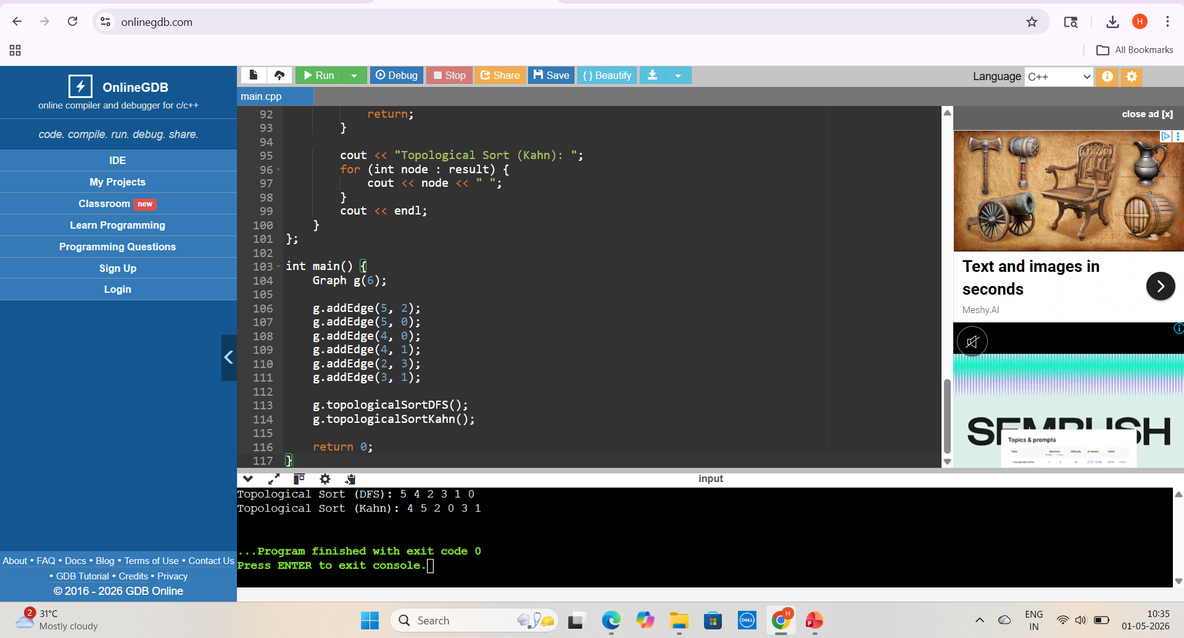
OUTPUT SCREENSHOT

Slide 8
TIME COMPLEXITY DERIVATION
DFS-Based Algorithm:
Vertex Traversal = O(V)
Edge Traversal = O(E)
Total = O(V + E)
Source-Removal Algorithm:
Indegree Calculation = O(E)
Queue Initialization = O(V)
Vertex Processing = O(V)
Edge Traversal = O(E)
Total = O(V + E)

Slide 9
CONCLUSION
• DAG effectively models dependency problems
• Topological Sorting provides valid task ordering
• DFS and Source-Removal both solve efficiently
• Both run in O(V + E) time
• Topological Sorting possible only for DAGs

